Slide 1


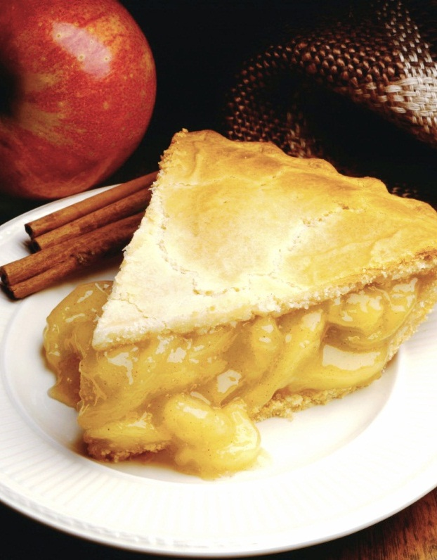
Restaurant Online Ordering System
Team Members: Gandeev Niraula, Sapana Poudel, Abdullah Ghurab

Slide 2
Motivation
An affordable small budget online ordering system for low budget food business.
Can be a game changer for small quick serve restaurants and food trucks.
This system can contribute in boosting the average order sizes and operational efficiency.
Reduce payroll expenses
Increases profit margin for restaurant.
Encourage Repeat Restaurant Customers.
Saves time for those employees who will have to take orders
Tentative Client: Food truck

Slide 3
How can it help Small Business Grow.
Problem | Solution
Manual Ordering can be resource and time consuming during busy hours and are more prone to errors. | Online Platform to place order helps in minimizing order errors.
Limited Budget | Small business often have limited budget so going online can boost productivity and staff can focus more on providing better customer experience or help other staff to get the work done.
Small restaurants require data analytics and statistics to create better strategies and grow their sales. | Going online can provide real time data about visitors, locations, abandoned carts etc. The business owner gets to know what people are ordering and what their preferences are. Location based data can help to strategize marketing and boost sales.
Real time Customization | Can help to make real time changes to menu, design, prices etc.

Slide 4
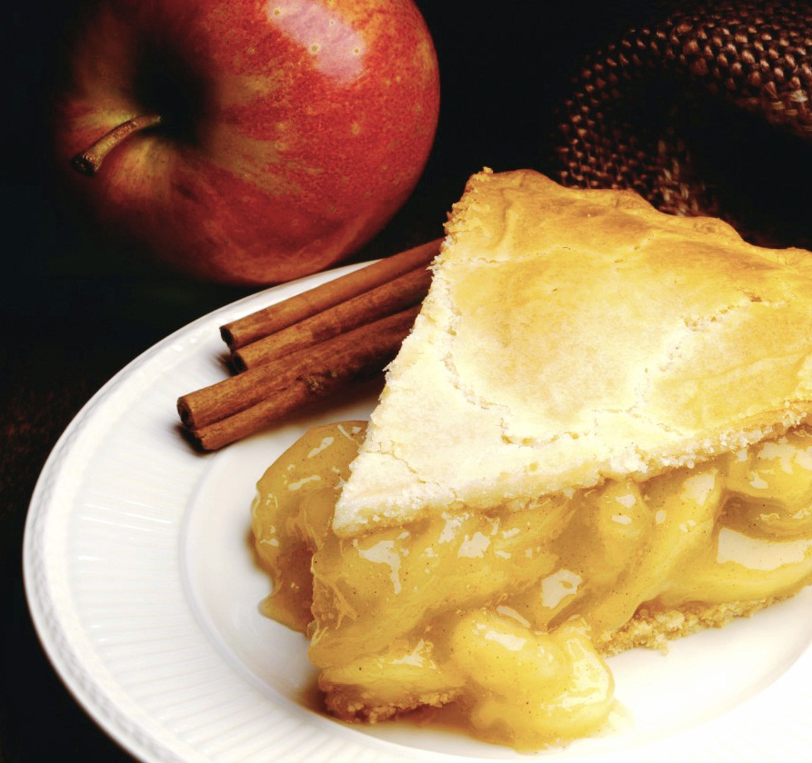
Fact…..
According to expert, digital ordering from computers, tablets, and mobile phones is growing 300 percent faster than dine-in traffic.

Slide 5
Cost of Third Party Vendor for Online Ordering System
GrubHub- It charges an average of 13.5% commission on every order. Lower rates are available but that means lower placement in search results for the restaurant
UberEats- it charges restaurants 30% for each order with an additional customer side charge
Eat24- it charges a fixed percent which results in 12.5% of a restaurant’s net online sales
Door Dash-It charges restaurant 10-25% depending on the restaurant and the market they are operating on
These commissions and fees mean that the more business a restaurant does online, the higher percentage of its sales go to the vendor.
Notes:
According Forbes, GrubHUb collects data on the behaviors of users placing more than 150,000 orders each day from nearly 29000 restaurant. But this data wasn’t share with restaurant clients because clients were not wiling to pay extra on top of 13.5% commission rate.

Slide 6
Third Party Vendor vs. Restaurant Ordering Software System
Third party vendor
Restaurant owned System
Online ordering with third-party vendor is an expensive venture with all the commissions and hidden fees
Data drives business but most vendors don’t provide their restaurant clients access to the customer data they collect as consumers place orders
Third party vendor attracts new customer but restaurant still has to pay commissions for a guest’s second and their order and so on
With them, the online ordering menu is hosted separately from the rest of the restaurant assets, and it is difficult and expensive to set up and make changes to menu items
Restaurant operators are essentially giving up control over their brand as restaurant clients has very little control over how they get represented on vendor’s site
Owing own’s system means there is no need to pay commissions and restaurant can keep more revenue from each online sale rather than giving away to third-party
Restaurant has access to customer’s contact information and detailed order, which help them to better understand the market
When customers order through restaurant’s site directly, it spared the commission fees
Online menu changes are as simple to make as they are in store
A restaurant’s System is built on the quality of the food, service, and overall guest experience

Slide 7

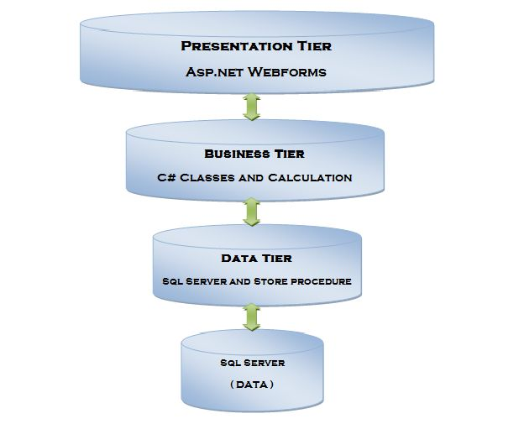
3-Tire Architecture in ASP.NET
Presentation Layer: the top-most level of application is the user-interface. The main function of the interface is to translate tasks and results by sending contents to browsers in the form of HTML/CSS/JS
Logic Layer: this layer coordinates the application, processes commands, make logical decisions, and perform evaluation and calculation. It also processes data between the presentation layer and data layer. It is written in C#.
Data Layer: Here information is stored and retrieved from database. The data is passed back to the logic layer for processing and back to the user. MSSQL is used in integrated environment in visual studio.

Slide 8
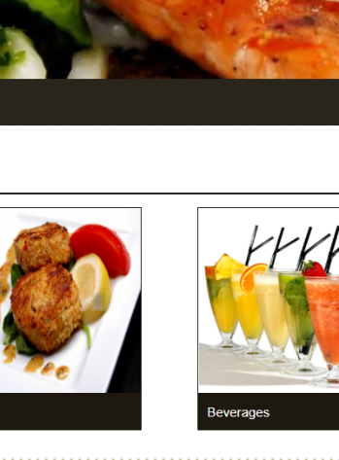
Advantage of 3-Tire Architecture
It gives the ability to update the technology stack of one tire, without impacting other areas of the application
It will make it easy to scale the application
It adds reliability and more independence of the underlying servers and services
As an owner, you have the ability to utilize new technologies as they become available and provides opportunity to redesign application and actually looks the need of future

Slide 9
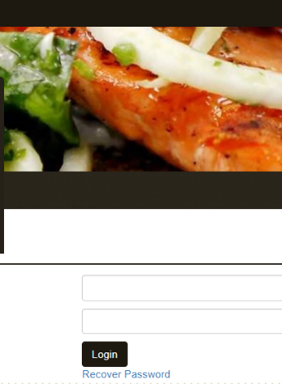
Progress On Project
We are using Visual Studio Community 2017 to build our project.
We have been able to complete following pages so far:
Master Page, Sign Up Page, Login Page, Menu Page, contact us, add to cart and update cart page.
We are currently working on admin panel where the admin will use the common login window with special username and password. The admin will have special privilege to add, delete and edit the menu details.
Currently, we are testing all of our pages locally using development server provided by Visual Studio.
As of now we hope to complete our project in the end of June if everything goes as planned.

Slide 10
On-Premise vs. Cloud-Based Restaurant POS System
On-Premise
Cloud-Based
It only allows on-premise access to data, which means you have to be in your restaurant in order to access the information
Initial investment, service fee and maintenance of traditional systems will be expensive
It requires manual updates that can be labor intensive and costly
If you anticipate growth or change in your business, traditional system will not be adaptable and scalable with new changes
Data can be accessed from anywhere, all you need is internet connection and a device
Cloud-based POS System tend to have cheaper operating costs in the long run when you pay as you go
Systems update automatically and is usually as simple as a few clicks
It is more adaptable and scalable. It also updates with new features as technology improves

